Slide 1

8th Grade Math: Pre-Algebra
Unit 1, Lesson 4 Evaluating Numeric Expressions – Part 1 Volume 1, pg. 21

Slide 2


Benchmark
MA.7.NSO.2.1
Solve mathematical problems using multi-step order of operations with rational numbers including grouping symbols, whole-number exponents, and absolute value.
volume 1, pg. 21

Slide 3
Integrated Mathematical Thinking and Reasoning Standards
MA.K12.MTR.3.1 Complete tasks with mathematical fluency.
MA.K12.MTR.4.1 Engage in discussions that reflect on the mathematical thinking of self and others.
MA.K12.MTR.5.1 Use patterns and structure to help understand and connect mathematical concepts.
volume 1, pg. 21

Slide 4

Learning Target
I can evaluate numeric expressions with up to four operations.
volume 1, pg. 21

Slide 5

Warm-Up
volume 1, pg. 21

Slide 6
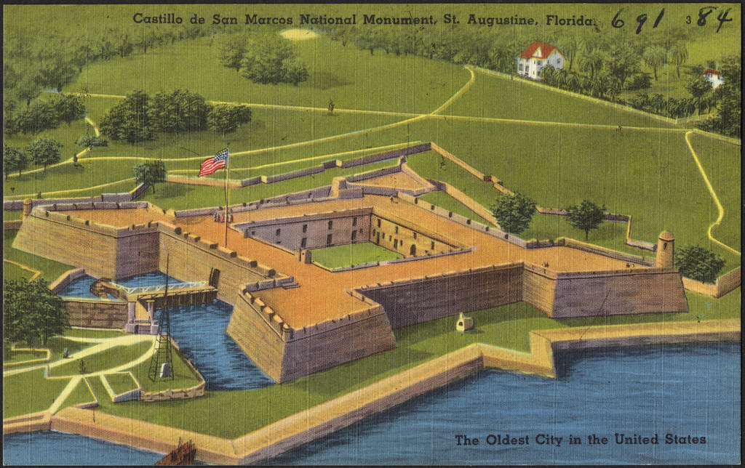
1.4.1 Warm-Up: Notice and Wonder
In 1672, the Castillo de San Marcos was built by the Spanish in St. Augustine, Florida to defend Florida and the Atlantic trade route.
volume 1, pg. 21

Slide 7
What do you notice about the design of the Castillo de San Marcos?
What do you wonder?
volume 1, pg. 21

Slide 8

Refresher
volume 1, pg. 22

Slide 9

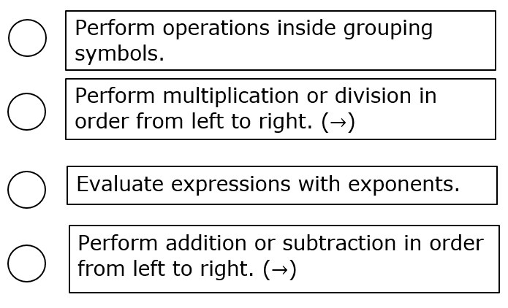
1.4.2 Refresher: Order of Operations
Work with a partner to number each operation so that the order of operations is in the correct order.
volume 1, pg. 22

Slide 10

Guided Practice
volume 1, pg. 22

Slide 11

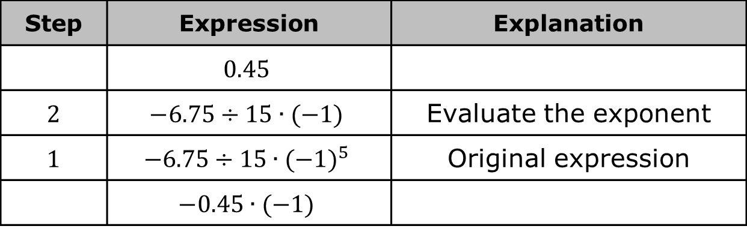
1.4.3 Guided Practice: Using the Order of Operations to Evaluate Numeric Expressions
For each table, an expression is evaluated, but the steps are mixed up. Order the expressions by writing the numbered step next to each expression shown. Explain the steps in the column on the right. The first table has been started.
Complete the table.
Step | Expression | Explanation
 | $$0.45$$
2 | $$−6.75÷15∙(−1)$$ | Evaluate the exponent
1 | $$−6.75÷15{∙(−1)}^{5}$$ | Original expression
 | $$−0.45∙(−1)$$
volume 1, pg. 22

Slide 12
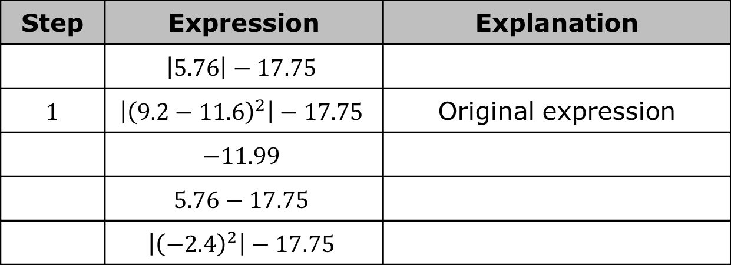
Complete the table.
Step | Expression | Explanation
 | $$\left|5.76\right|−17.75$$
1 | $$\left|{\left(9.2−11.6\right)}^{2}\right|−17.75$$ | Original expression
 | $$−11.99$$
 | $$5.76−17.75$$
 | $$\left|{\left(−2.4\right)}^{2}\right|−17.75$$
volume 1, pg. 22

Slide 13

Evaluate each expression using the order of operations.
a. ${ (−5+4.5)}^{3}−|−8.7|$
b. ${\left(\frac{4.1−2.5}{−2}\right)}^{2}×(−9)$
c. $−7.1+2\left|1.46−9.2\right|$
volume 1, pg. 23

Slide 14

Collaboration
volume 1, pg. 23

Slide 15

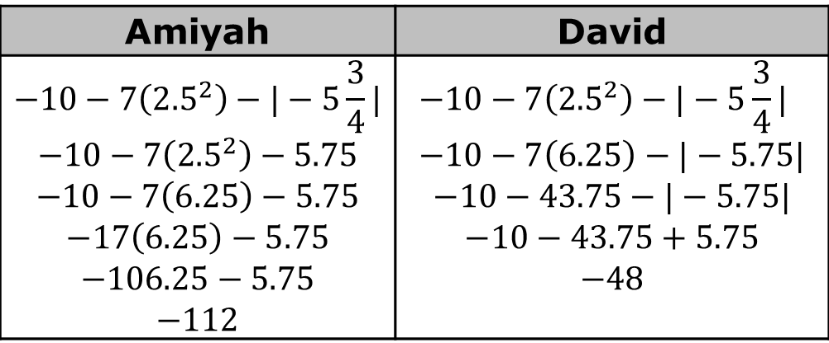
1.4.4 Collaboration: Using Order of Operations
Amiyah and David simplified the same expression using an order of operations and arrived at two different solutions. Their work is shown.
Amiyah | David
$$−10−7\left({2.5}^{2}\right)−|−5\frac{3}{4}|$$ $$−10−7\left({2.5}^{2}\right)−5.75$$ $$−10−7\left(6.25\right)−5.75$$ $$−17\left(6.25\right)−5.75$$ $$−106.25−5.75$$ $$−112$$ | $$−10−7\left({2.5}^{2}\right)−|−5\frac{3}{4}| \\ −10−7\left(6.25\right)−|−5.75|$$ $$−10−43.75−|−5.75|$$ $$−10−43.75+5.75$$ $$−48$$
volume 1, pg. 23

Slide 16
Amiyah and David both made common mistakes. Circle the mistakes in the work.
Write a note to Amiyah and David explaining the mistake(s) they made.
Amiyah | David
Evaluate the expression correctly.
volume 1, pg. 23

Slide 17

Activity
volume 1, pg. 24

Slide 18

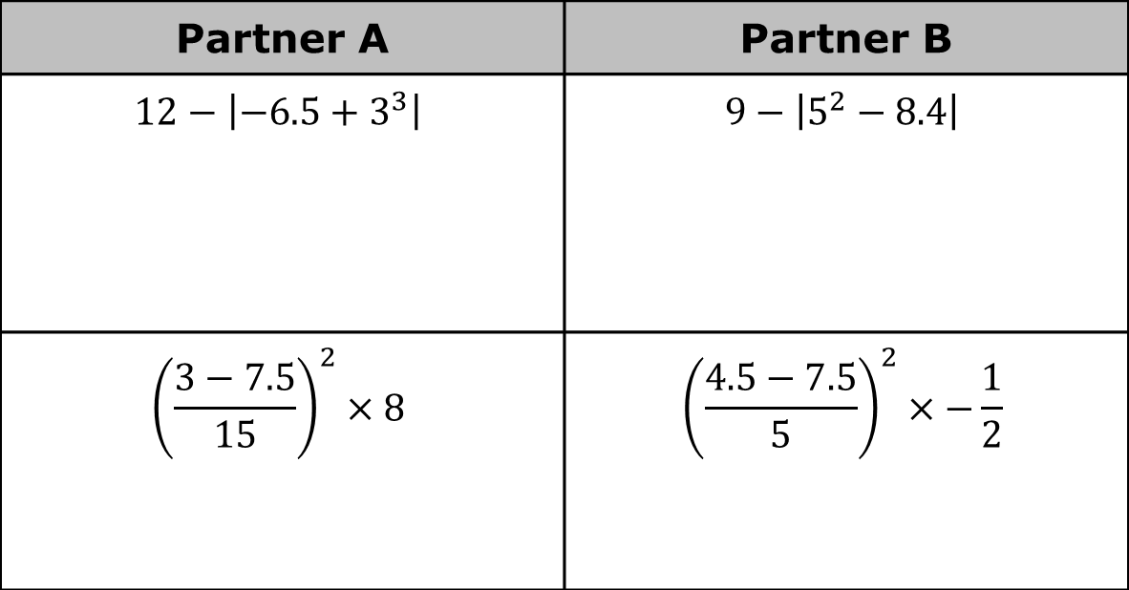
1.4.5 Activity: Evaluating Expressions
Decide with your partner who will be Partner A and who will be Partner B.
Evaluate the problems in your column.
Partner A | Partner B
$$12−\left|−6.5+3^{3}\right|$$ | $$9−\left|5^{2}−8.4\right|$$
$${\left(\frac{3−7.5}{15}\right)}^{2}×8$$ | $${\left(\frac{4.5−7.5}{5}\right)}^{2}×−\frac{1}{2}$$
volume 1, pg. 24

Slide 19
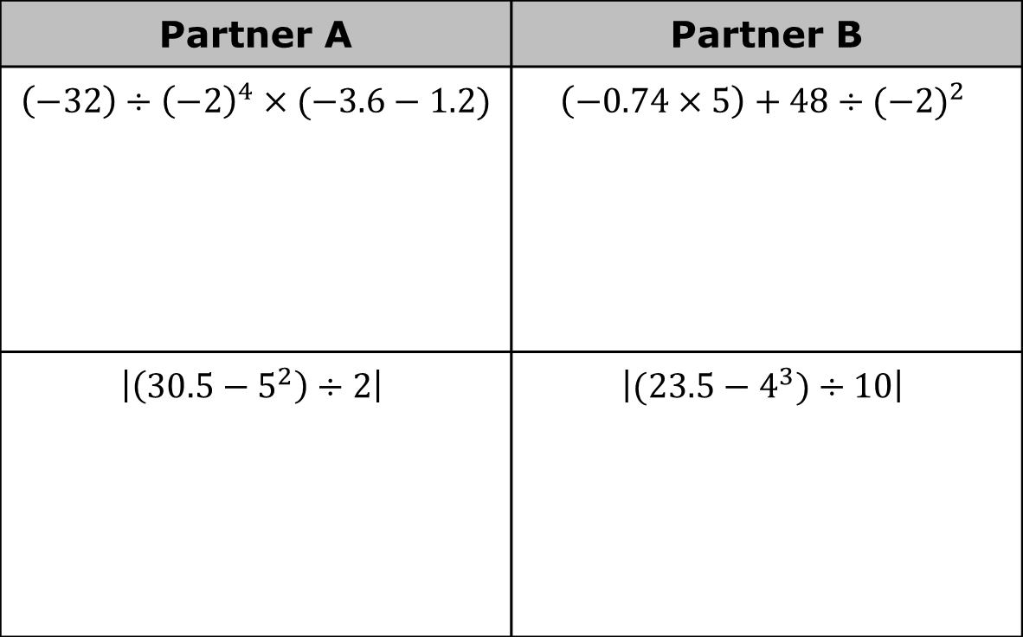
Partner A | Partner B
$\left(−32\right)÷{\left(−2\right)}^{4}×(−3.6−1.2)$ | $$\left(−0.74×5\right)+48÷(−{2)}^{2}$$
$$\left|\left(30.5−5^{2}\right)÷2\right|$$ | $$\left|(23.5−4^{3})÷10\right|$$
volume 1, pg. 24

Slide 20
Calculate the sum of the answers in each column from Part A.
Both columns should have the same sum. If that is not the case, work with your partner to find and correct any errors in your work.
Sum of Partner A’s Answers | Sum of Partner B’s Answers
volume 1, pg. 24

Slide 21

Your Turn
volume 1, pg. 25

Slide 22

1.4.6 Your Turn!
Evaluate each expression. Show the steps in your work.
a. $−4.5−|{\left(3×−1.6\right)}^{2}|$
b. $\frac{{{(−9}^{0}× 0.2)}^{4}}{−2}$
c. $(−18.6)÷6∙{(−2.3+5.4)}^{2}$
d. ${[{\left(−3\right)}^{1}×\left(3.7−5.8\right)]}^{3}$
volume 1, pg. 25

Slide 23

Wrap-Up
volume 1, pg. 25

Slide 24
1.4.7 Wrap-Up: Cool Down
For each statement, write whether you agree with it, disagree with it, or are unsure.
Statement | Agree/Disagree/Unsure
The more digits a number has, the larger it is.
When you add two positive decimals together, the value is always larger.
To add exponents, their bases must be the same.
volume 1, pg. 25

Slide 25
Statement | Agree/Disagree/Unsure
The product of two fractions is always a larger number.
The sum of a positive and a negative number is always negative.
volume 1, pg. 25

